Slide 1
Simulations of ISING MODEL
For square lattice and triangular lattice under various conditions for antiferromagnetic cases

Slide 2
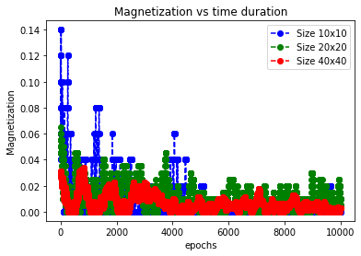
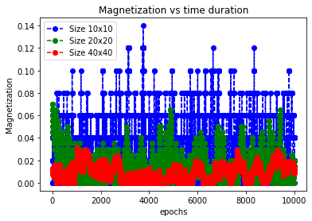
QUENCHING For anti-ferromagnetic case J1=-1 and J2=-1
Graph of magnetization for quenching for square lattice T=0.5
Graph of magnetization for quenching for triangular lattice T=0.5

Slide 3
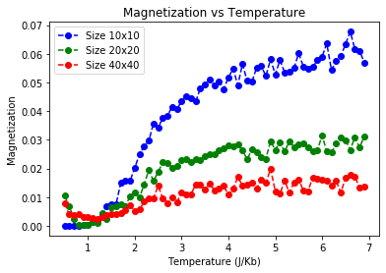
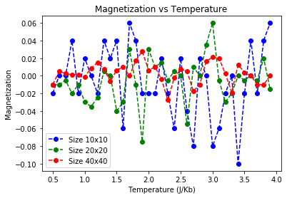
Magnetization vs temperature for anti-ferromagnetic case J1=-1 J2=-1
Square Lattice
A constant external magnetic field H=0
Triangular Lattice
A constant external magnetic field H=0

Slide 4
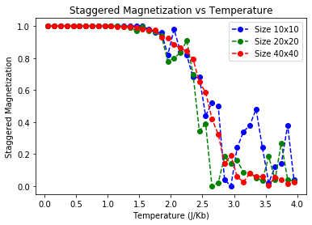
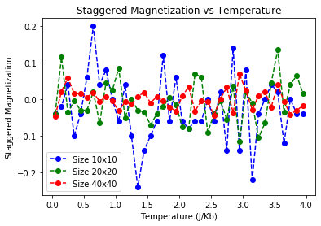
Magnetization(staggered) vs temperature for anti-ferromagnetic case J1=-1 J2=-1
Square Lattice
A constant external magnetic field H=0
Triangular Lattice
A constant external magnetic field H=0

Slide 5

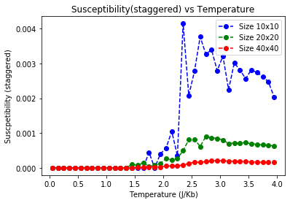
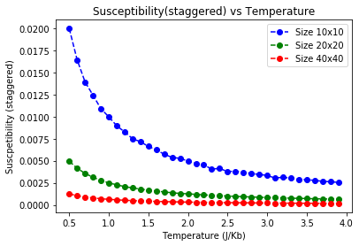
Susceptibility(staggered) vs temperature for anti-ferromagnetic case J1=-1 J2=-1
Square Lattice
A constant external magnetic field H=0
Triangular Lattice
A constant external magnetic field H=0

Slide 6
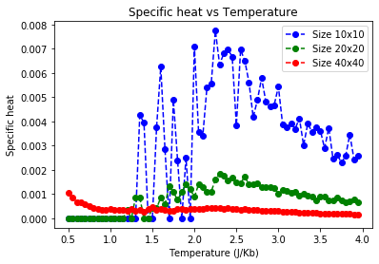
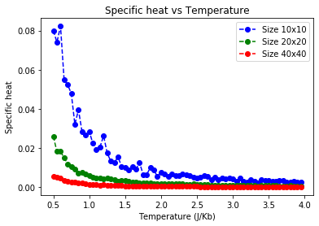
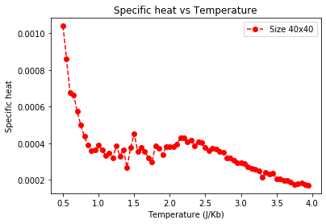
Specific heat vs temperature for anti-ferromagnetic case J1=-1 J2=-1
Square Lattice
A constant external magnetic field H=0
Triangular Lattice
A constant external magnetic field H=0

Slide 7
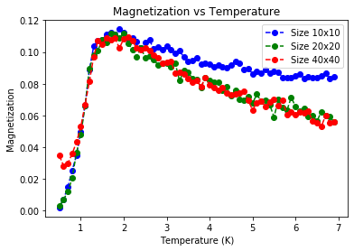
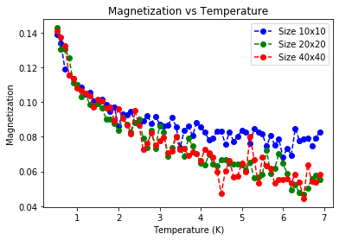
Square Lattice
A constant external magnetic field H=1
Triangular Lattice
A constant external magnetic field H=1

Slide 8
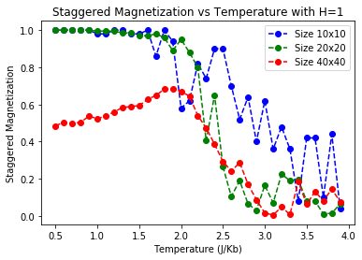
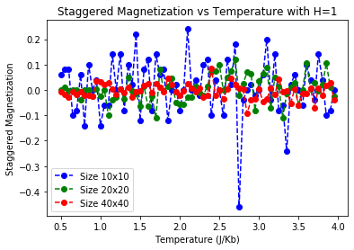
Magnetization(staggered) vs temperature for anti-ferromagnetic case J1=-1 J2=-1; H=1
Square Lattice
A constant external magnetic field H=1
Triangular Lattice
A constant external magnetic field H=1

Slide 9
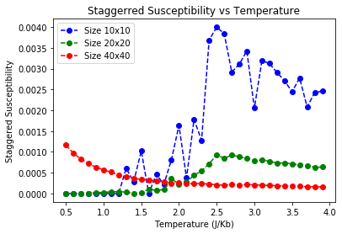
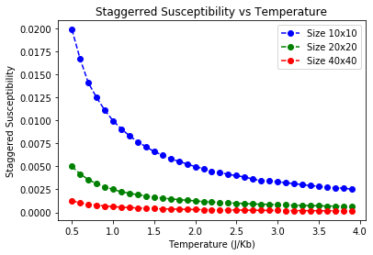
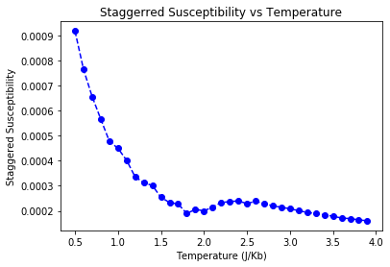
Susceptibility(staggered) vs temperature for anti-ferromagnetic case J1=-1 J2=-1
Square Lattice
A constant external magnetic field H=1
Triangular Lattice
A constant external magnetic field H=1

Slide 10
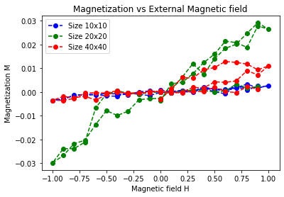
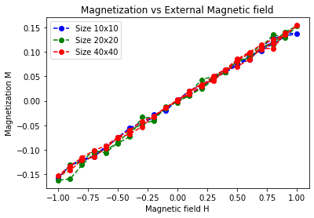
Hysteresis loop for square lattice at T=0.5
Hysteresis loop for triangular lattice at T=0.5

